Slide 1
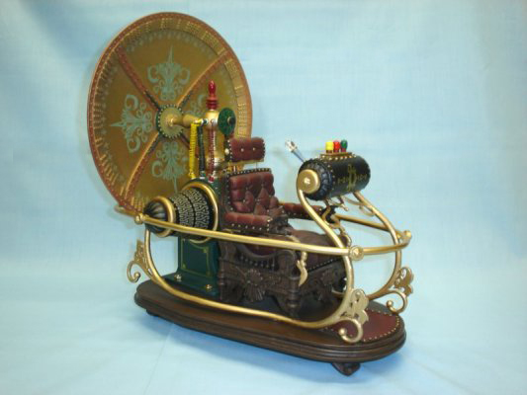
Machine Learning, Cybersecurity and Beyond Seeing the Past, Present, and Future
David Meyer
SP CTO and Chief Scientist

Slide 2
Agenda
Macro Trends Circa 2012: Seeing The Past, Present and Future
What is Machine Learning?
Machine Learning, Anomaly Detection and Cybersecurity
CTO’s Office Machine Learning Initiatives
Industry Cybersecurity Landscape
Summary
Q&A

Slide 3

Macro trends

Slide 4

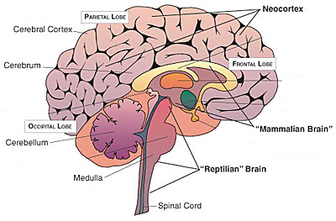
The Evolution of Intelligence
Reptilian Brain to Neocortex → Hardware to Software
HARDWARE
SOFTWARE
Notes:
The point here is that the future is in Software (Software, Software Software!)

Slide 5
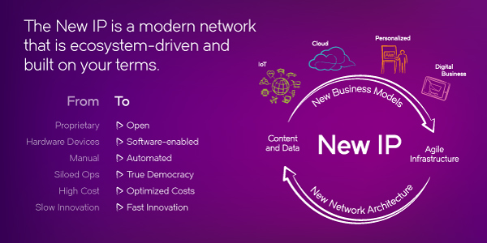
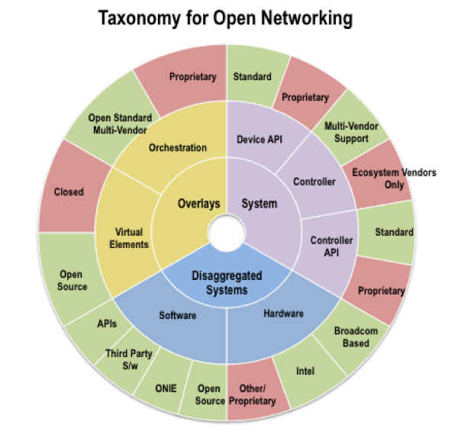
The Three Main Points I Made Back in 2012
Software
Software is how we’re going to evolve intelligence, speed and flexibility
Past: Hardware Oriented Solutions
Present: Software speed/flexibility, OpenDaylight, Open Stack, MANO, …
Open
We will make Brocade into the OPEN company
Past: Proprietary, Closed Solutions
Present: Community, OpenDaylight, Open Stack, MANO, APIs, …
Disaggregation
Decomposition/disaggregation is the way to create flexibility, add value
Past: Vertical Integration
Present: Service chains, Open Daylight, NFV, APIs, Protocols, Portable OSes, …
BTW, we have a name for this these days

Slide 6
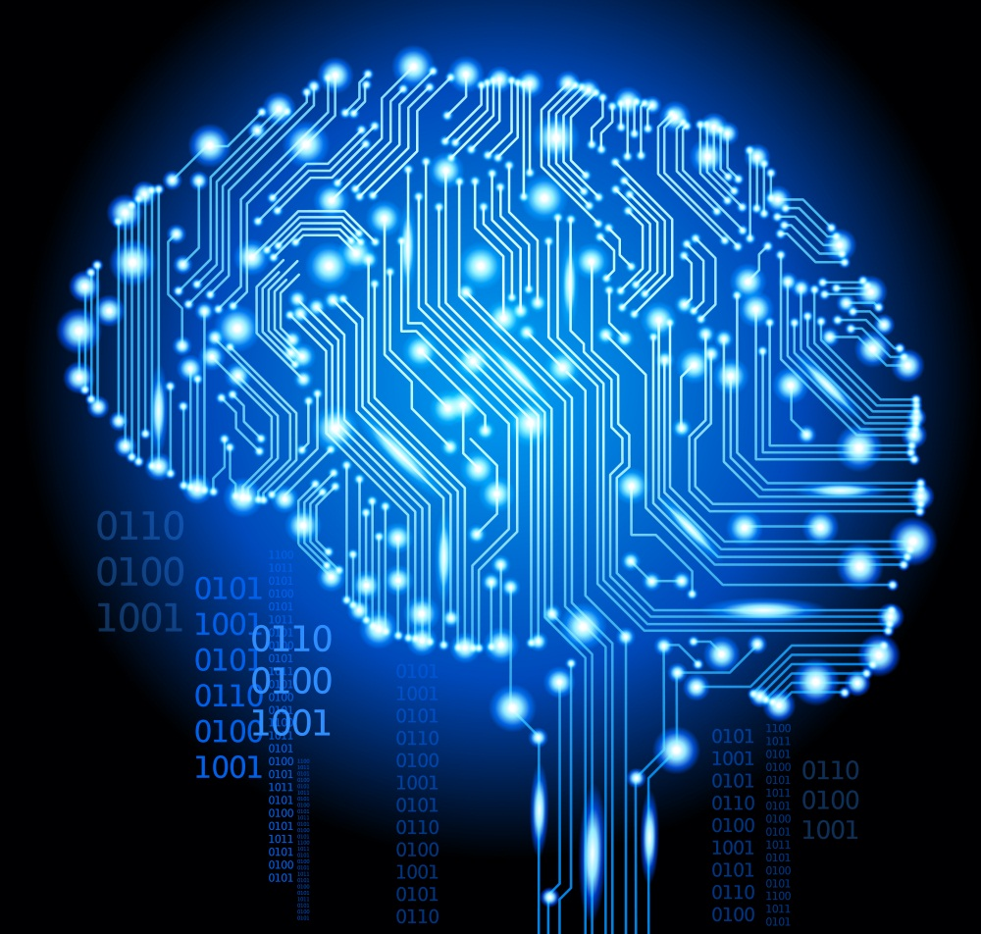
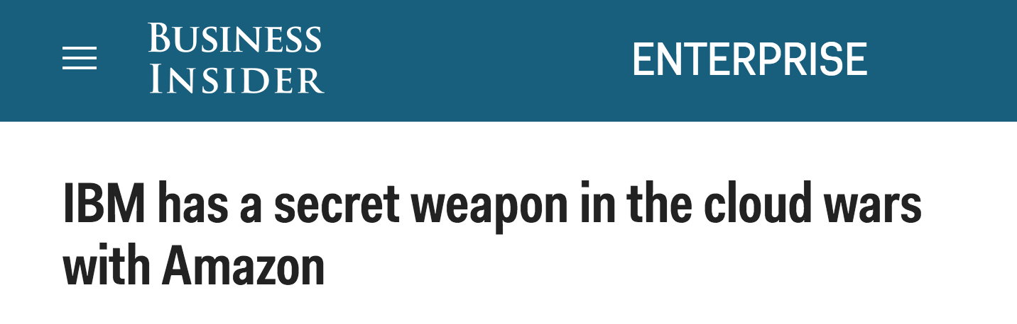
2015 Macro Trends (Seeing the Future)
The Rise of Machine Intelligence
Most of the knowledge in the world of the future will be extracted by and reside in machines.
-- Yann LeCun, Director of AI Research at Facebook

Slide 7
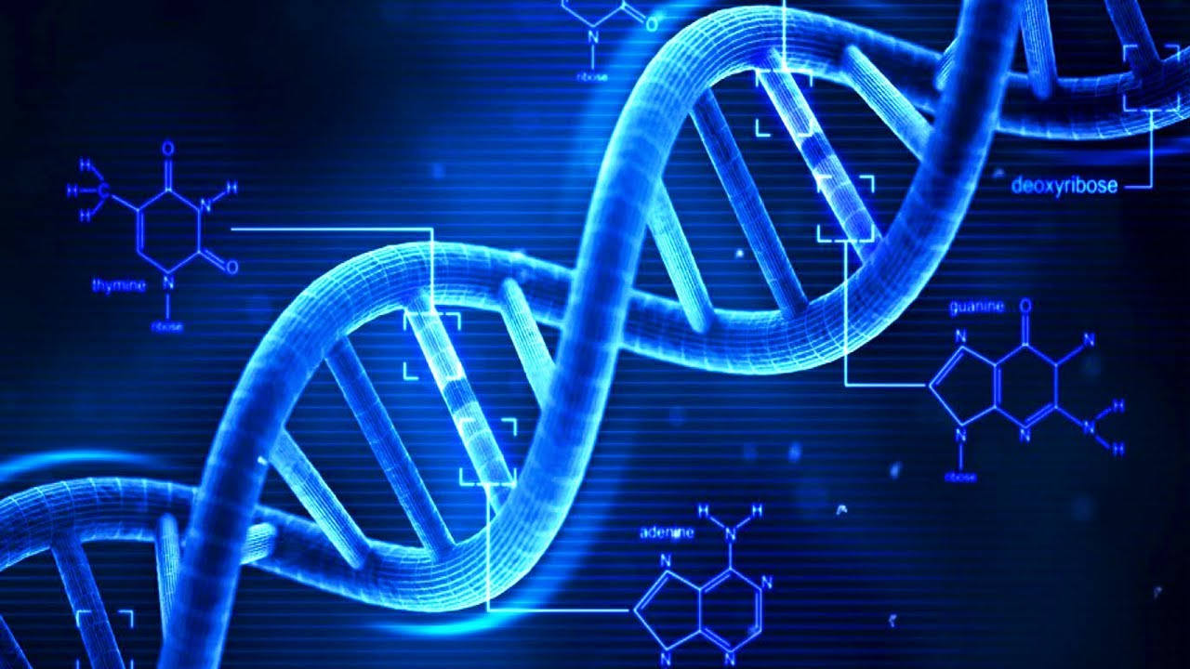
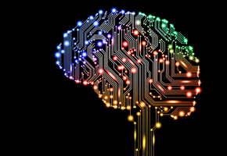

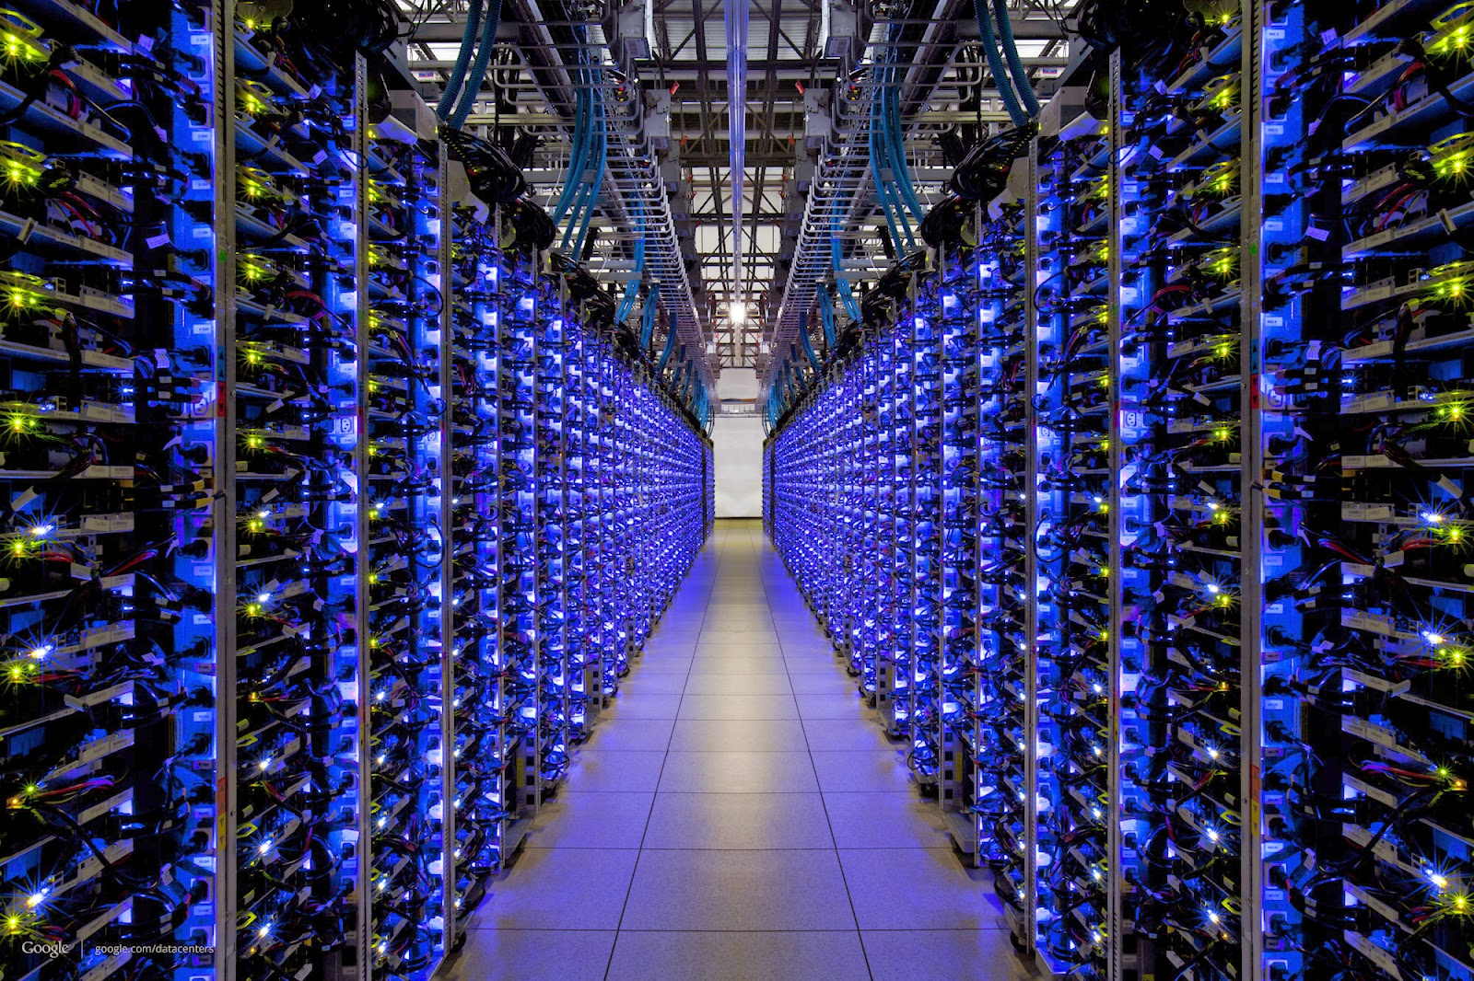
Ok, The Future (Present) Is Going To Be Knowledge Based But Where Does Knowledge Come From?
Evolution
Experience
Many orders of magnitude
faster and larger
Culture
Machines

Slide 8
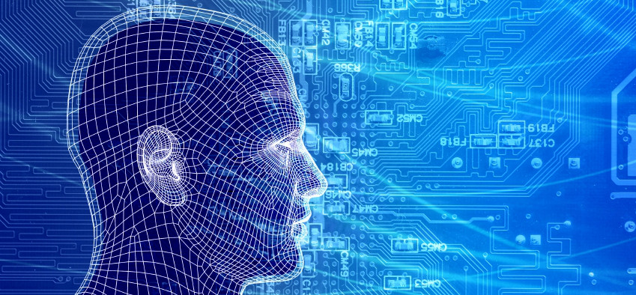
So How Can Machines Discover New Knowledge?
Fill the gaps in existing knowledge
Symbolists
Technology: Induction/Inverse Deduction
Emulate the brain
Connectionists
Technology: Deep neural nets
Emulate evolution
Evolutionaries
Technology: Genetic Algorithms
Systematically reduce uncertainty
Bayesians
Technology: Bayesian Inference
- Notice similarities between old and new
Analogizers
Technology: Kernel machines/Support Vector Machines
These correspond to the 5 major schools of thought in machine learning

Slide 9
Agenda
Macro Trends Circa 2012: Seeing The Past, Present and Future
What is Machine Learning?
Machine Learning, Anomaly Detection and Cybersecurity
CTO’s Office Machine Learning Initiatives
Industry Cybersecurity Landscape
Summary
Q&A

Slide 10

So What is Machine Learning?
The complexity in traditional computer programming is in the code (programs that people write). In machine learning, learning algorithms are in principle simple and the complexity (structure) is in the data. Is there a way that we can automatically learn that structure? That is what is at the heart of machine learning.
-- Andrew Ng
Said another way, we want to discover the Data Generating Distribution (DGD) that underlies the data we observe. This is the function that we want to learn. That is, we learn the function from data.
Moreover, we care about primarily about the generalization accuracy of our model (function)
Accuracy on examples we have not yet seen
as opposed the accuracy on the training set (note: overfitting)

Slide 11
The Same Thing Said in Cartoon Form
Traditional Programming
Machine Learning
Data
Computer
Output
Program
Data
Computer
Program
Output

Slide 12

Ok, What is all the Excitement About? Context and Framing
Lots of excitement around “analytics” and machine learning
But what are “analytics”?

Slide 13
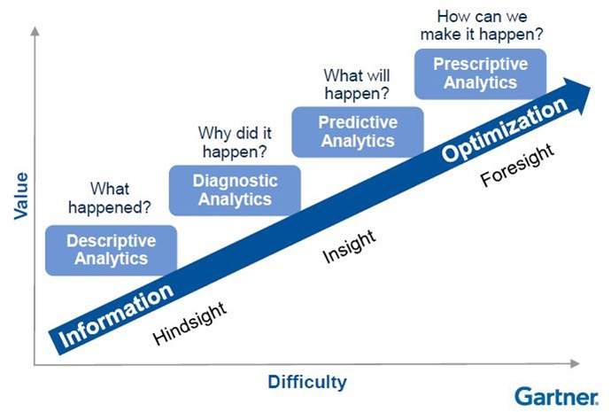
Conventional View of the Analytics Space
Focus here

Slide 14
Another Way To Think About This
The Automation Continuum
Management plane perspective
Machine Learning
Average Enterprise
Industry Pioneers
CONTROLLER-BASED ARCHITECTURE
CLI SCRIPTING
CLI
Manual
Automated/Dynamic
CLI
AUTOMATION
Machine
Intelligence
INTEGRATION
PROGRAMMABILITY
DEVOPS / NETOPS
ORCHESTRATION
Original slide courtesy Mike Bushong and Joshua Soto
Notes:
Most customers are at the very early side of this continuum of maturity when it comes to automating the network. They may have a couple of expect scripts, some MOPs and SOPs, but things are not really automated in any really meaningful way. They don’t have any sort of control framework or controller, not using OpenStack, not interested in programmability. Most want the network to be easier to manage.
Companies such as Netflix, are at the furthest end of the spectrum using a much more fully integrated Dev/NetOps approach
Our job is not to paint a picture of our customer’s full operational maturity, our job is to show them that we know what full operational maturity looks like and then get them further down the continuum in that direction.
Present in the industry today is a huge separation between where customers are today and the “vision” that everyone is talking about.
Your role as a sales person, is to be the TRUSTED ADVISOR that doesn’t judge the customer for where they are, but can identify their current pain point and point to a path to full operational maturity over the next several years.
Mike’s analogy for a 22hr treadmill session

Slide 15
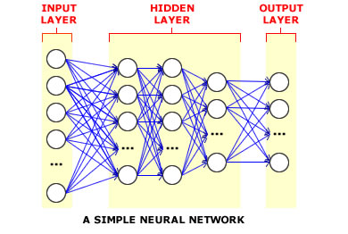
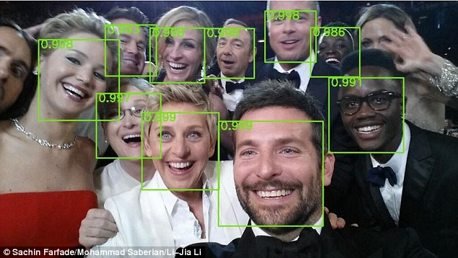
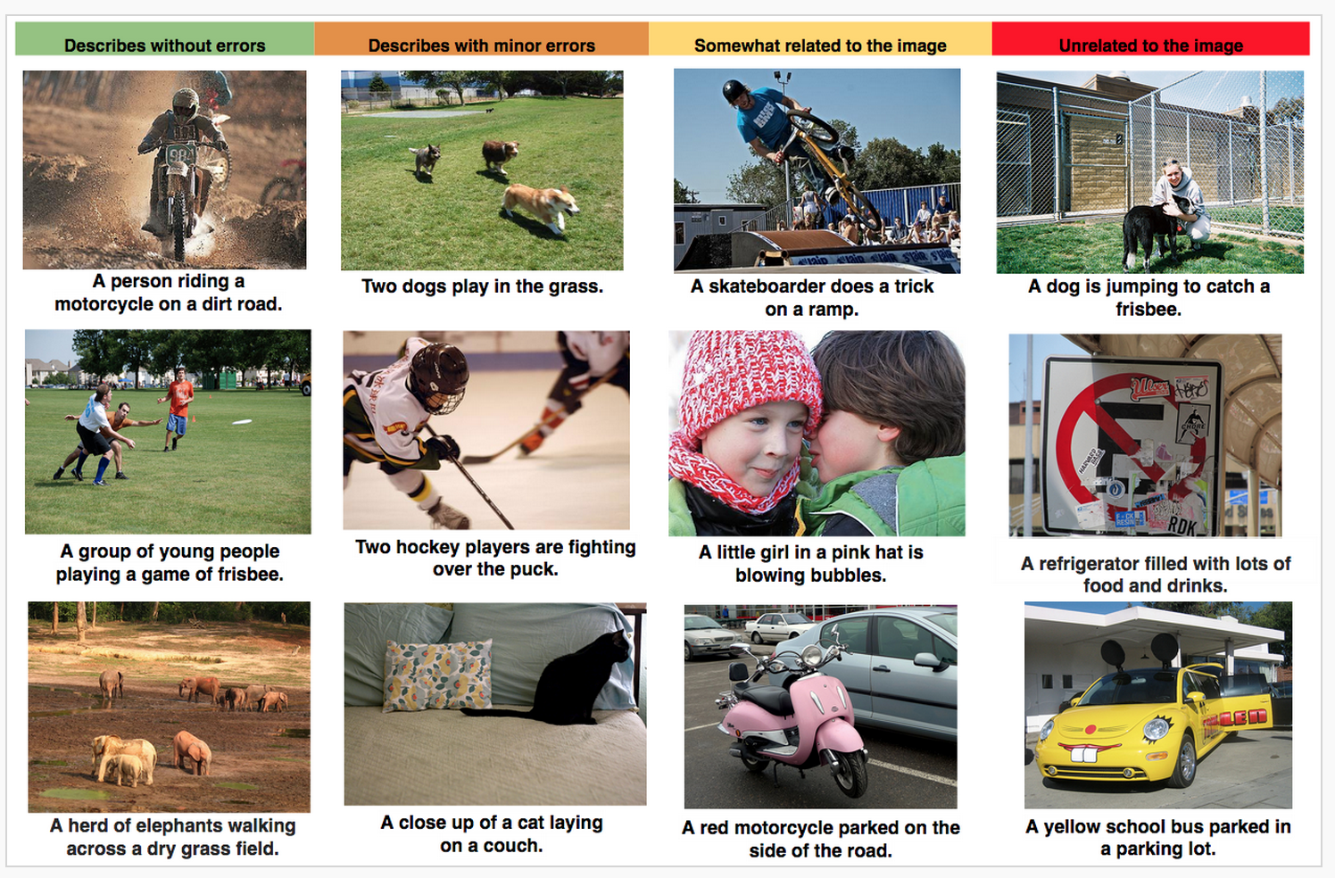
Still, What is All the ML Excitement About?
Deep learning is enjoying great success in an ever expanding number of use cases
Multi-hidden layer neural networks
“Perceptual” tasks reaching super-human performance
Networking/non-cognitive domains still lagging
Networking is a relatively new (but recently active) domain for ML
Security space currently most active (more on this later)
Auto-Captioning
Object Recognition
Why this is relevant: Network use cases will (eventually) use similar technologies

Slide 16
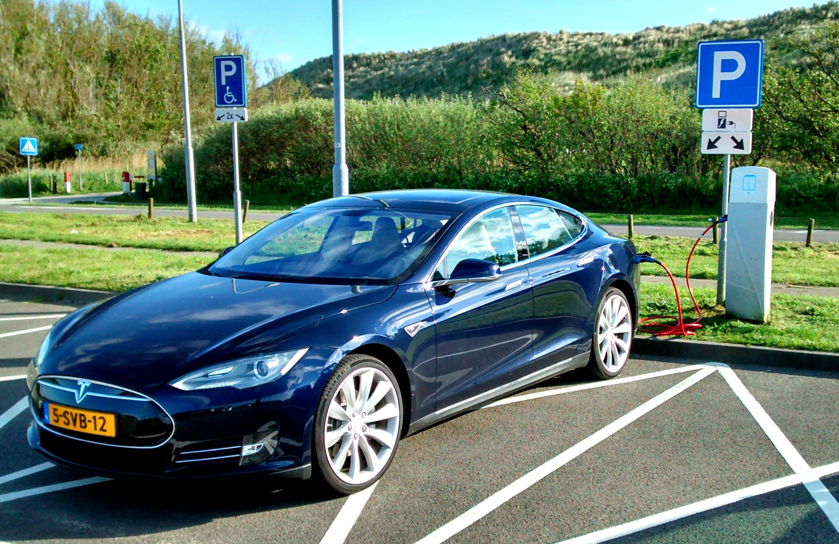
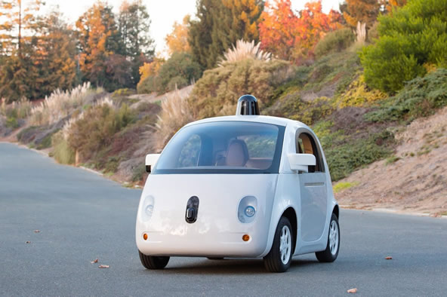

Self-Driving Cars
Autopilot ™
Networked
Learning
Cars
Notes:
Note massive 750Mb/

Slide 17



Toyota An Industry in Transition: “Nuts and Bolts” → Intelligent Technology Platform
$$≈$$
Nuts and Bolts $≈Speeds and Feeds$

Slide 18
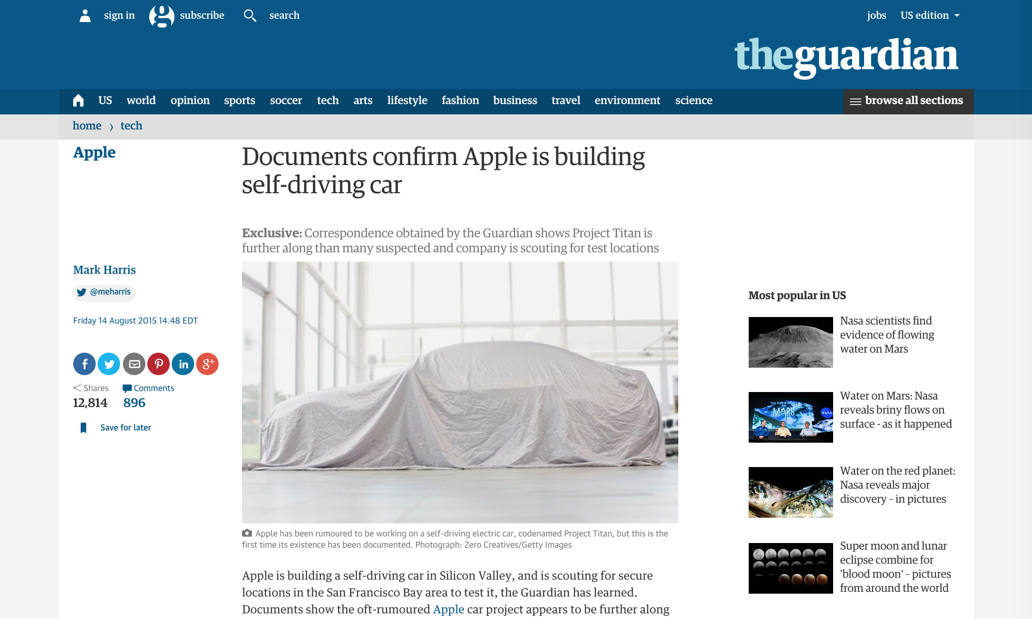
Apple

Slide 19

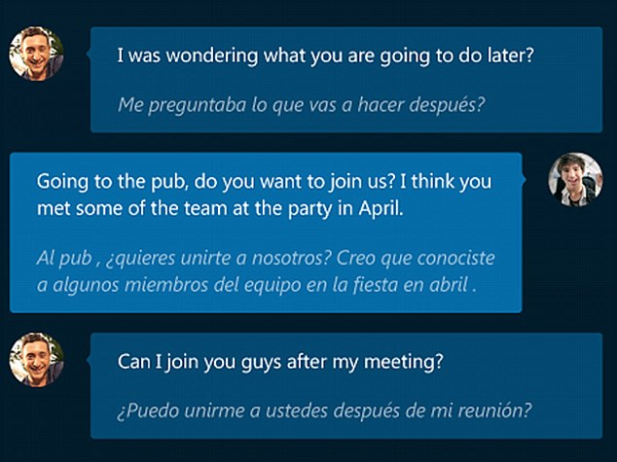
But There’s More
Skype Real-Time Translation

Slide 20
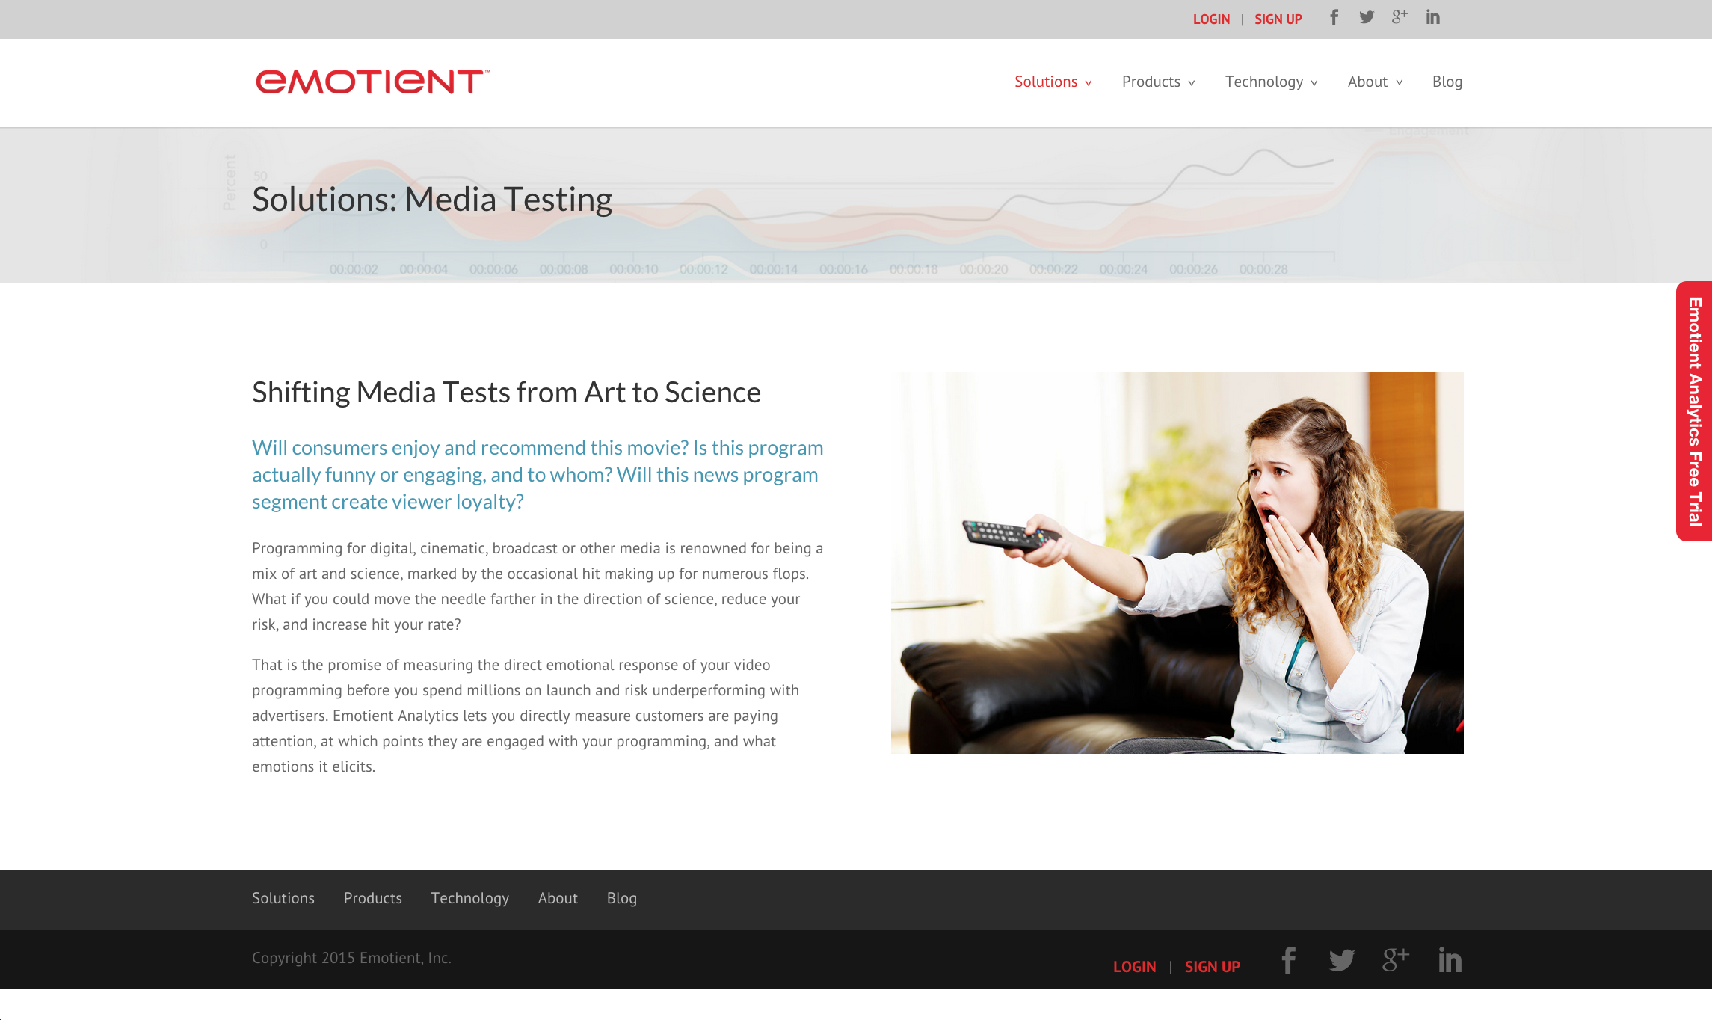
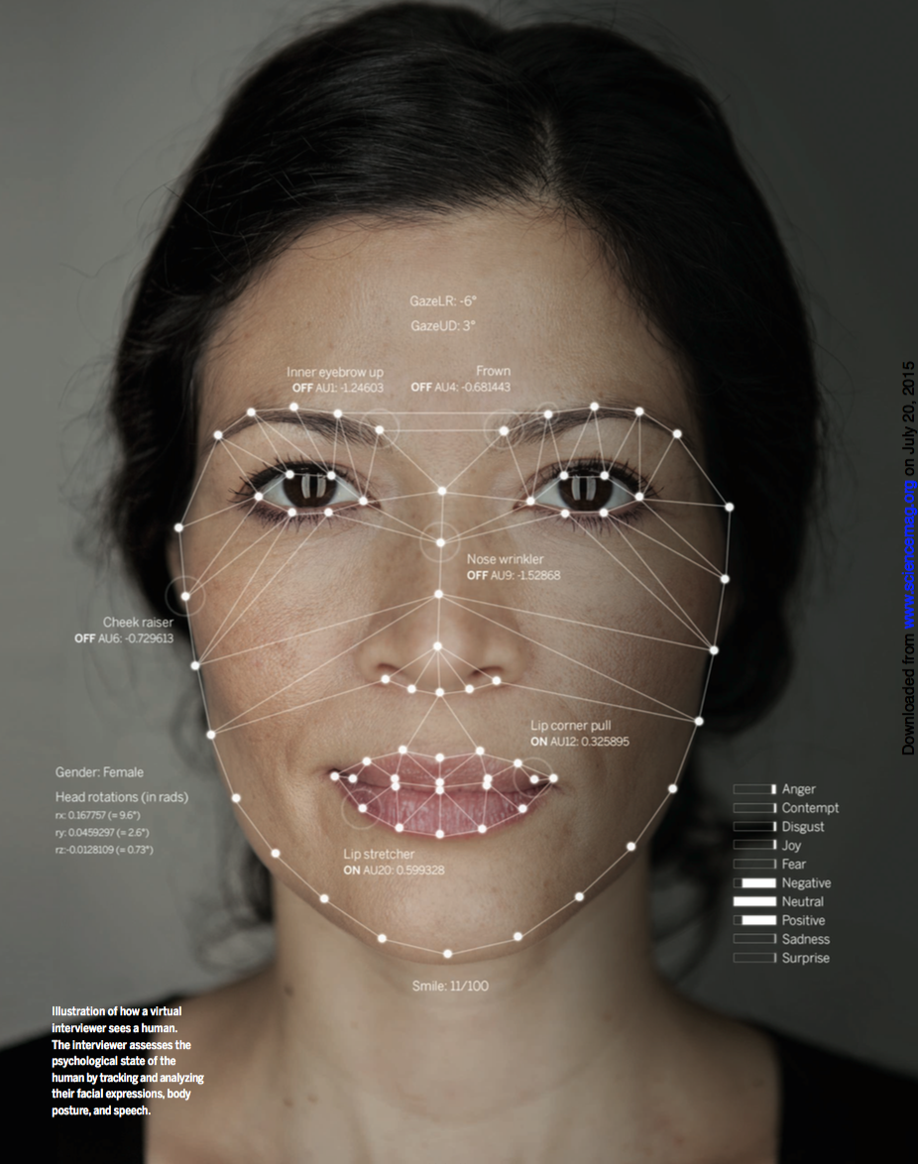
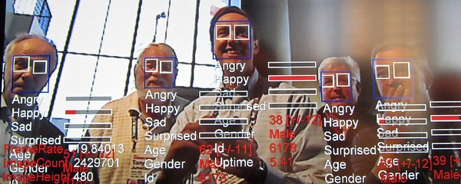
Think Speech/Object Recognition is Impressive?
Emotion Analysis

Slide 21
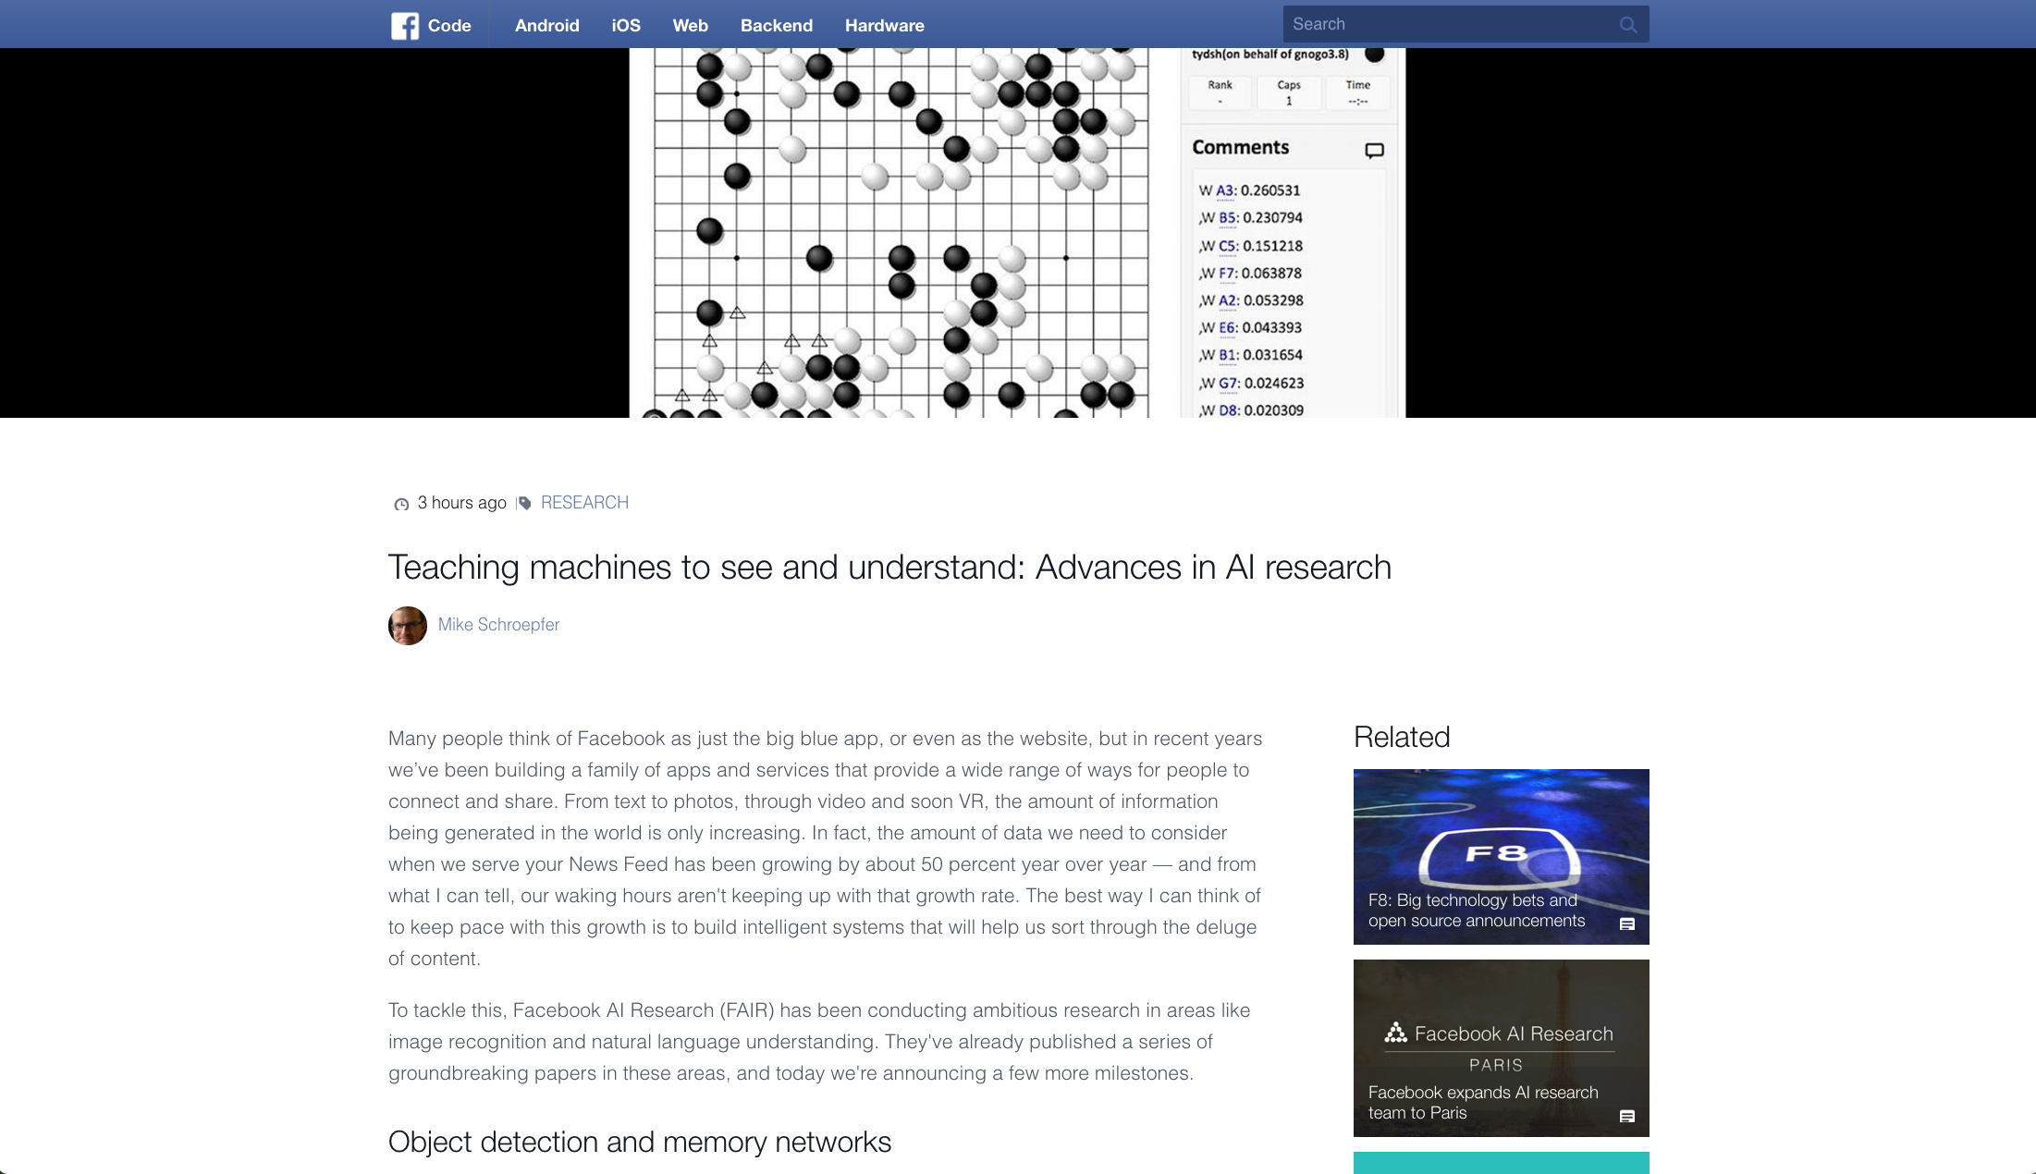
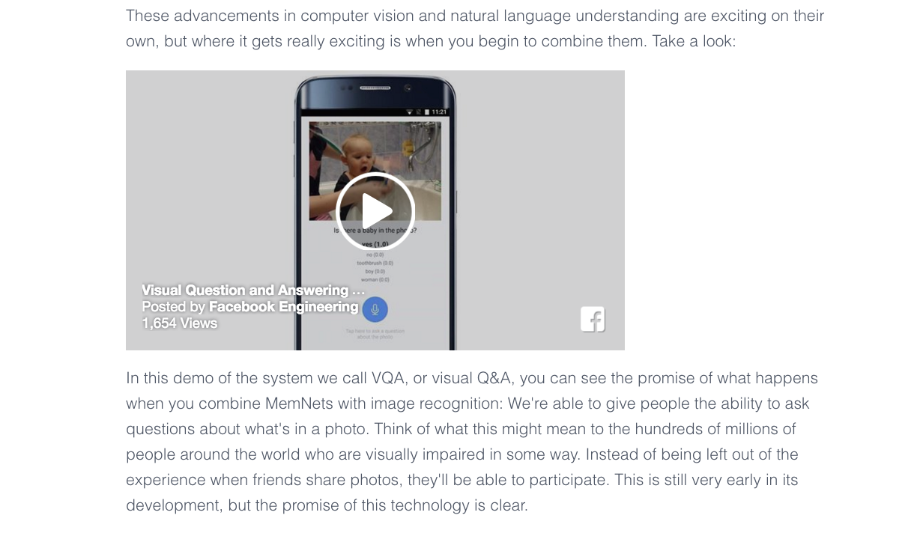
Facebook ,Google and Baidu are the New
Centers of the AI/Machine Learning Universe
Facebook’s state of the art voice activated ML system uses Convolutional Neural Networks and Memory Networks that answers question about image content
https://code.facebook.com/posts/1478523512478471/teaching-machines-to-see-and-understand-advances-in-ai-research/

Slide 22
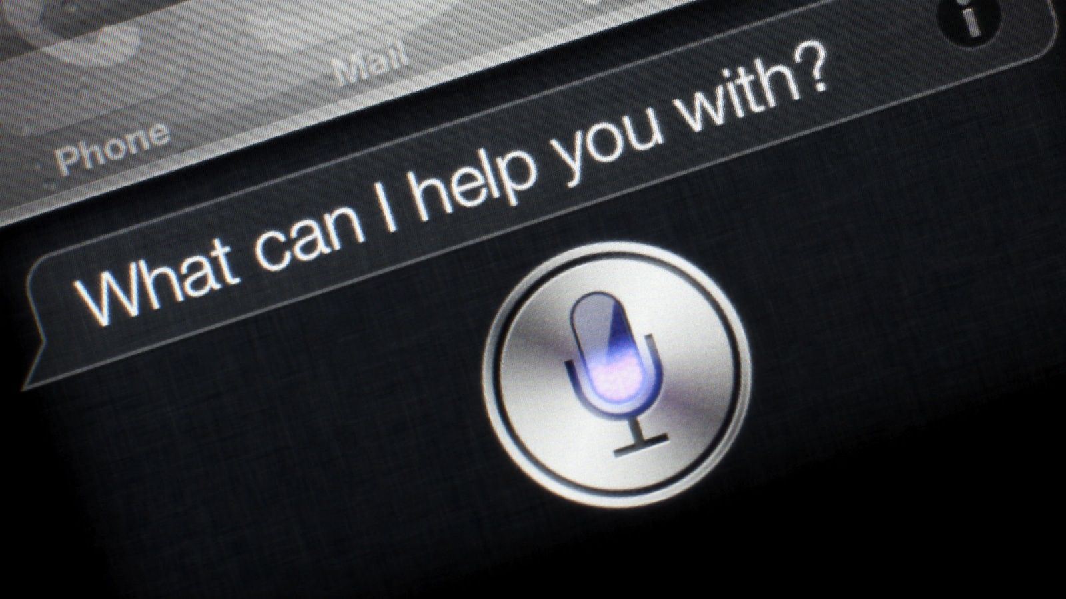


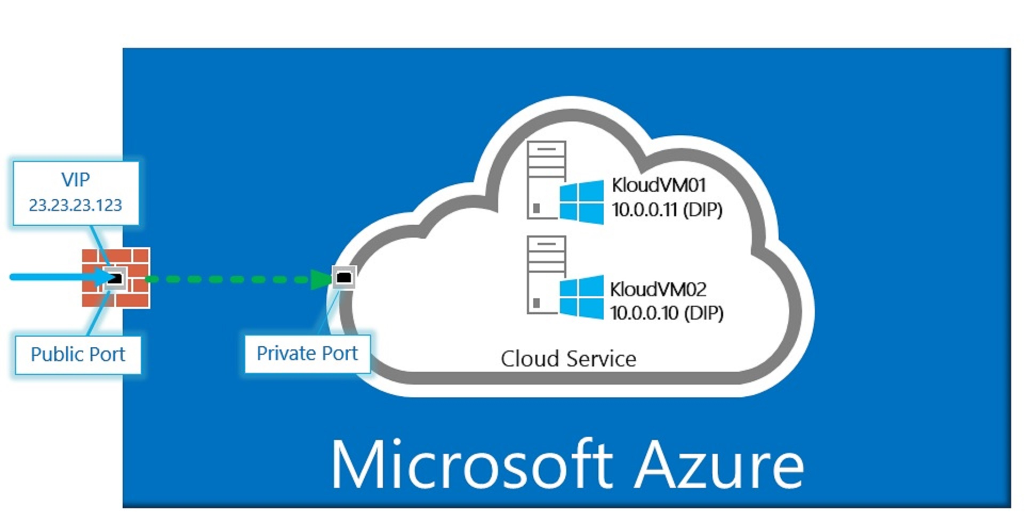

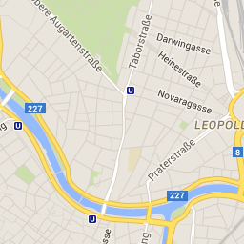
Other ML Applications You Interact with Everyday

Slide 23
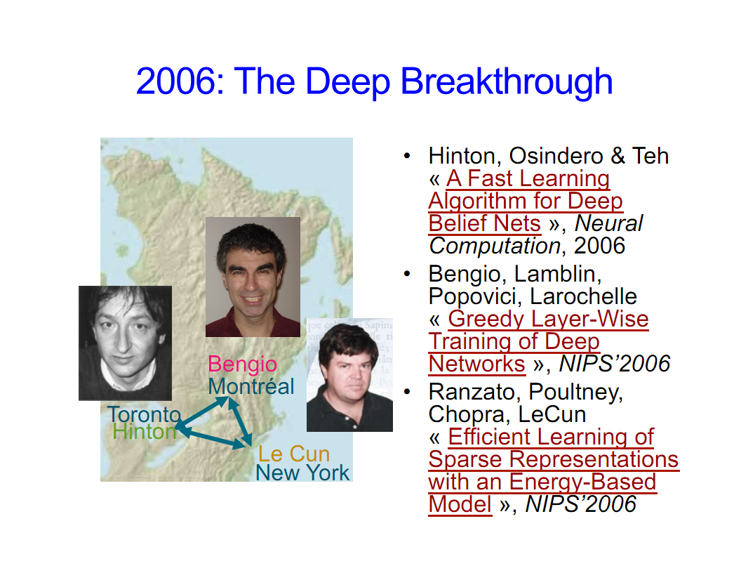
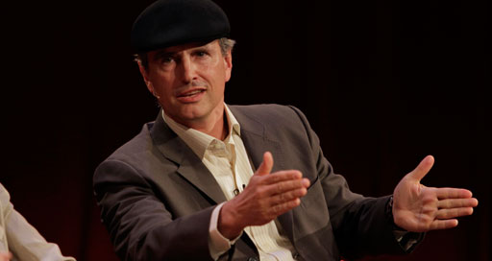
Why is all of this all happening now?
Before 2006 people thought deep neural networks couldn’t be trained
So why now?
Theoretical breakthroughs in 2006
Learned how to train deep neural networks
Unsupervised “initialization” of deep nets
More recently: http://www.cs.toronto.edu/~fritz/absps/momentum.pdf
Nice overview of LBH DL journey: http://chronicle.com/article/The-Believers/190147/
Compute
CPUs were 2^20s of times too slow
Parallel processing/algorithms
GPUs + OpenCL/CUDA
Datasets
Massive data sets: Google, FB, Baidu, …
And the convergence of theory/practice in ML
Alternate view of history?
LBH Nature DL review: http://www.nature.com/nature/journal/v521/n7553/full/nature14539.html
Jürgen Schmidhuber’s critique : http://people.idsia.ch/~juergen/deep-learning-conspiracy.html
LBH rebuttal: http://recode.net/2015/07/15/ai-conspiracy-the-scientists-behind-deep-learning/
Image courtesy Yoshua Bengio

Slide 24
Agenda
Macro Trends Circa 2012: Seeing The Past, Present and Future
What is Machine Learning?
Machine Learning, Anomaly Detection and Cybersecurity
CTO’s Office Machine Learning Initiatives
Industry Cybersecurity Landscape
Summary
Q&A

Slide 25
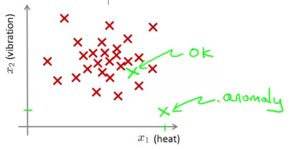
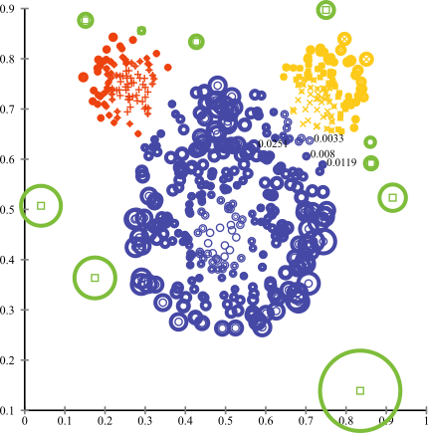
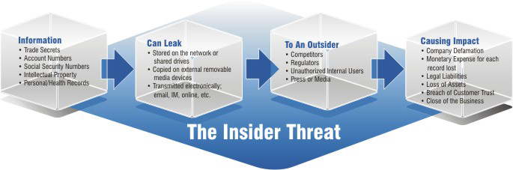
Now, We Want To Apply This Technology To Networking Anomaly Detection for Cybersecurity (and Beyond)
What is an anomaly? Intuitively, an anomaly is a pattern that does not conform to the expected behaviour
How to define expected behaviour?
How to find the “outliers”?
Technically: Learn a binary classifier
Anomalies translate to significant real world events
Cyber crime
Manufacturing/product defects
...
Linear Decision Boundary

Slide 26
Basic Idea Behind Anomaly Detection
An anomaly
Idea: Assume that a boundary exists and that - Nominal data is inside the boundary - Anomalous data is outside the boundary
Problem: How to estimate/approximate the boundary?
Problem: What measurement(s) caused the anomaly?
Collected ‘Nominal’ Data
Problem: How far off-nominal is the anomaly/feature?

Slide 27
Simple Example
N₁ and N₂ are regions of normal behaviour
Say, normal flows in a network
Points o₁ and o₂ are anomalies
Points in region O₃ are anomalies
Challenge:
How to define “normal” regions?
How to find the outlier points?
This is the job of machine learning
Y
N₁
o₁
O₃
o₂
N₂
X

Slide 28

Anomaly Detection Schemes
General Steps
Build a profile of the “normal” behavior
Profile can be patterns or summary statistics for the overall population
Use the “normal” profile to detect anomalies
Anomalies are observations whose characteristics differ significantly from the normal profile
Types of anomaly detection schemes
Graphical & Statistical-based
Distance-based
Model-based
FP Mining, K-means, …

Slide 29
3 Main Types of Anomaly
Point Anomalies
Contextual Anomalies
Collective Anomalies

Slide 30
Point Anomalies
An individual data instance is anomalous if it deviates significantly from the rest of the data set.
Y
Anomaly
N₁
o₁
O₃
o₂
N₂
X

Slide 31
Contextual Anomalies
Individual data instance is anomalous within a context
Requires a notion of context
Also referred to as conditional anomalies
Anomaly
Normal

Slide 32
Collective Anomalies
A collection of related data instances is anomalous
Requires a relationship among data instances
Sequential Data
Spatial Data
Graph Data
The individual instances within a collective anomaly are not anomalous by themselves
Anomalous Subsequence
Anomalous Subsequence

Slide 33
Key Challenges for Anomaly Detection Algorithms
Defining a representative normal region is challenging
The boundary between normal and outlying behaviour is often not precise
The exact notion of an outlier is different for different application domains
Availability of labelled data for training/validation (unsupervised learning)
Malicious adversaries
Data is very noisy
False positive/negatives
Normal behaviour keeps evolving

Slide 34
Agenda
Macro Trends Circa 2012: Seeing The Past, Present and Future
What is Machine Learning?
Machine Learning, Anomaly Detection and Cybersecurity
CTO’s Office Machine Learning Initiatives
Industry Cybersecurity Landscape
Summary
Q&A

Slide 35
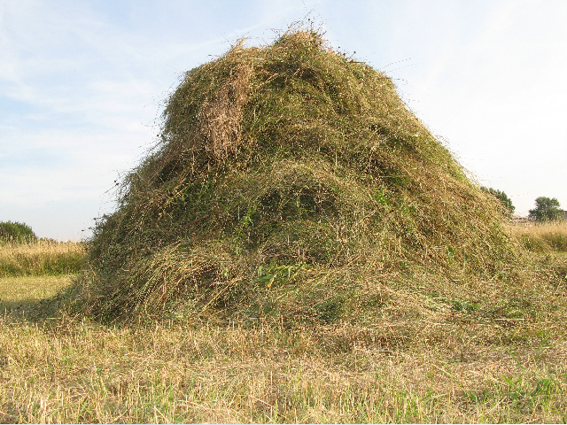
CTO’s Office Machine Learning Initiatives
Small Machine Learning team in the CTO’s Office
Cybersecurity/Anomaly Detection
Initial focus on Federal Customers/Cybersecurity
Secure Load Balancing,…
“Intelligence Engine” for SDN and NFV DevOPs applications
False Positive Mitigation (statistical noise reduction, reputation, …)
NFV Predictor/Orchestration/VSAM
Controller path optimization (and other) applications
vEPC applications
Internally facing applications
Brocade Service Vision
Manufacturing
Pioneering Machine Learning for Networking (and CSNSE in general)
Looking for a needle here

Slide 36
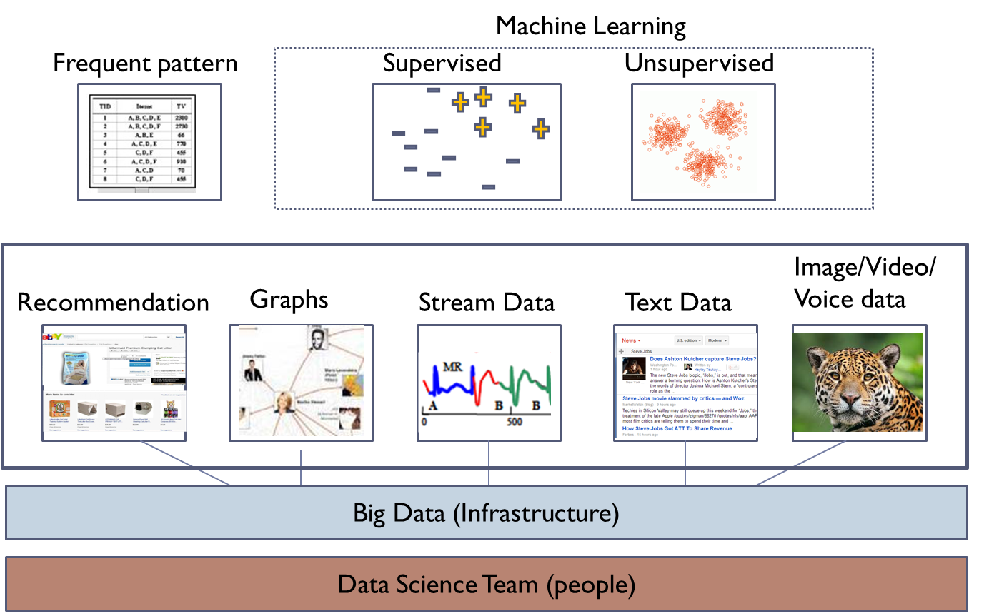
How We View the Network Intelligence Stack
Consider:
What needs to
run “on box”?

Slide 37
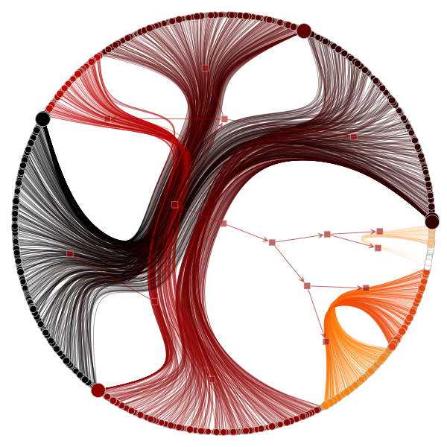
Example: Preprocessing Network Data
This work occurs at the “Big Data” level of the stack
before Machine Learning is applied
Gives us an easier path to “linear seperability”
Linear Decision Boundary
Generalization Graph Radial Nested Block State Model with Edge Bundling

Slide 38
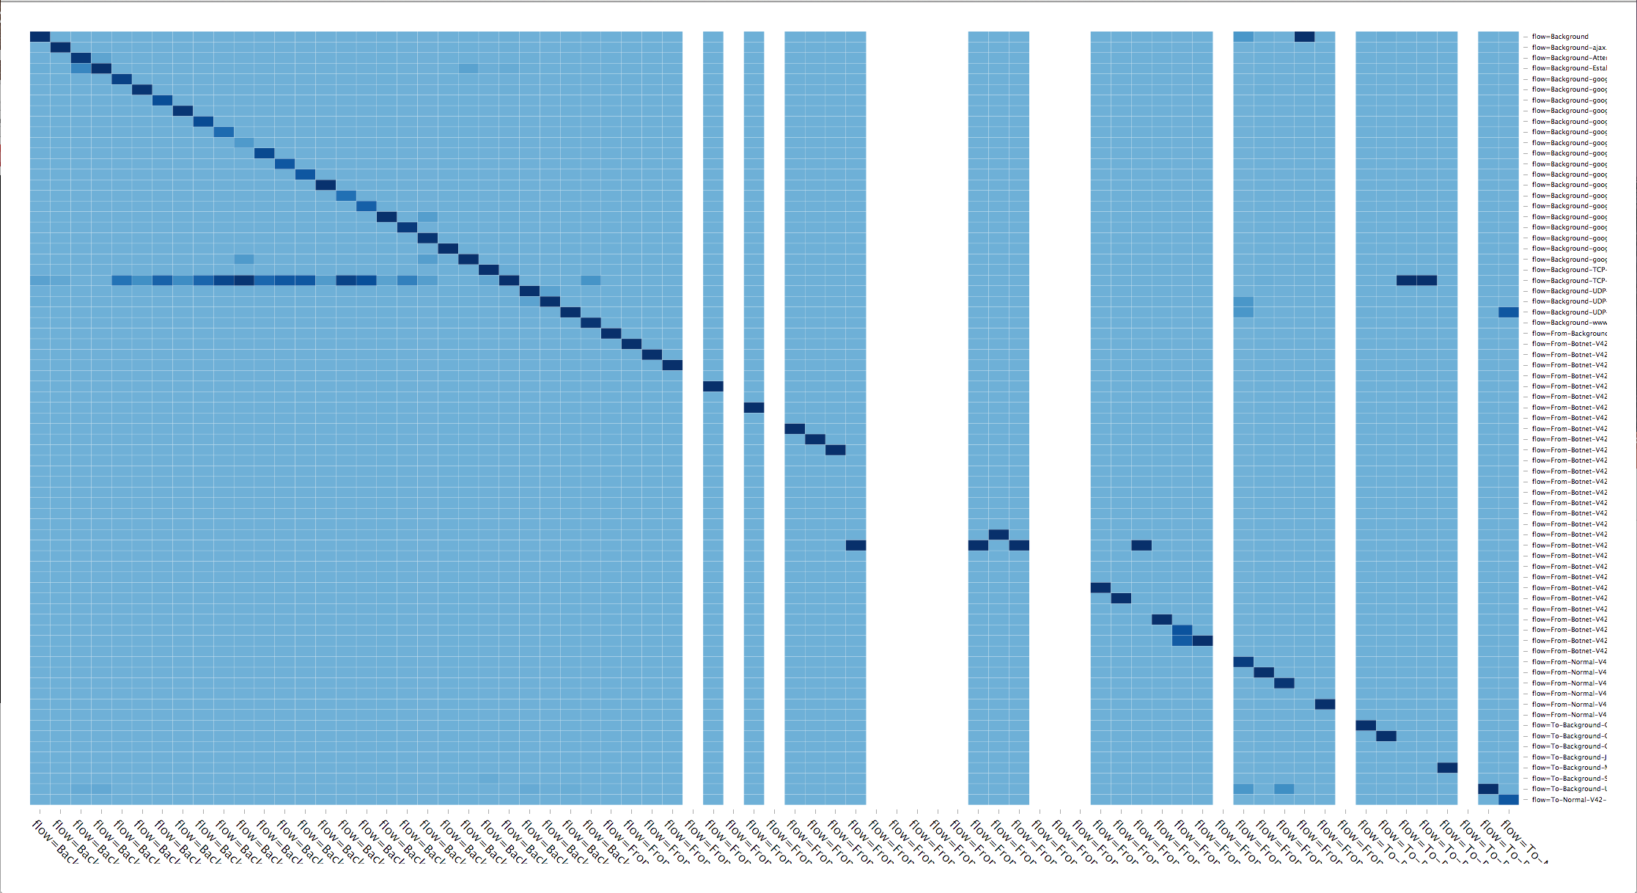
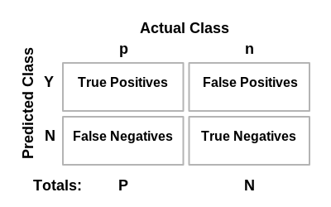
Example: Visualizing Anomaly Detection Efficiency Confusion Matrix
Briefly: What is a confusion matrix?

Slide 39
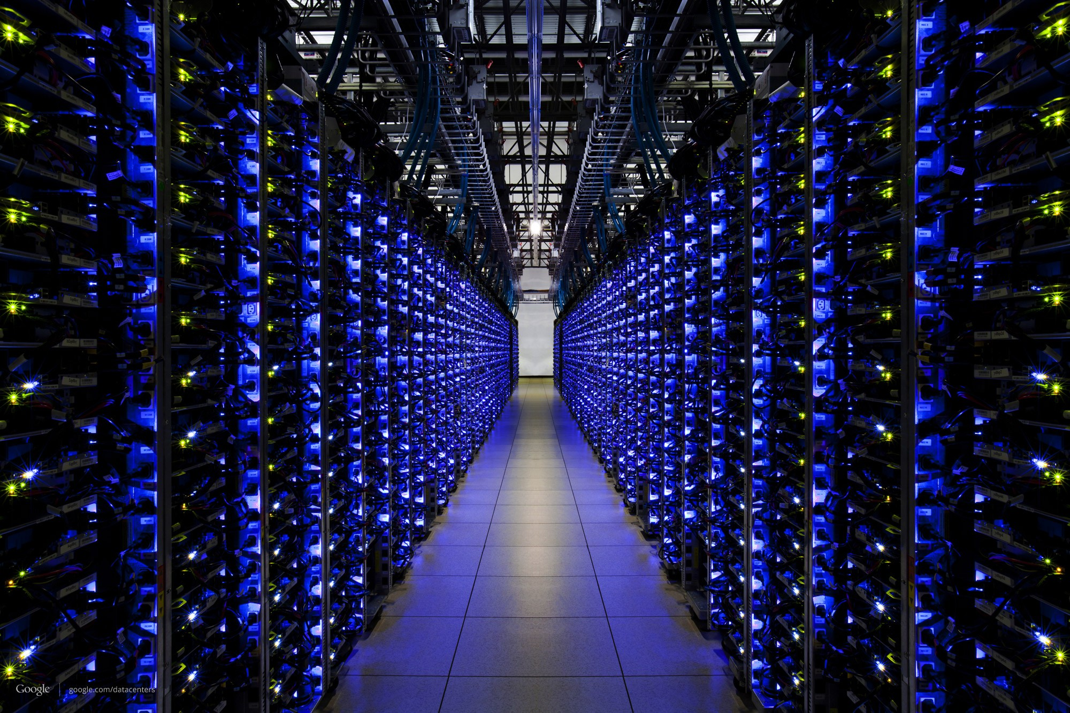
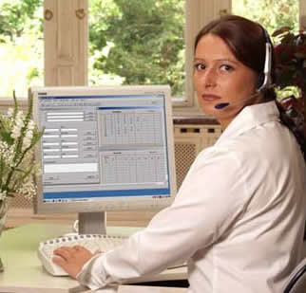
Brocade Network Machine Learning Workflow Schematic
Intellectual Property
Data Collection
Cleaning
Storage
(Flow, PCAP, …)
Machine
Learning
False Positive Reduction
- Statistical Noise Filtering
- White/Black Listing
- Reputation
Customer Scoring
Other Feedback

Slide 40
Other Machine Learning Use Cases
Tools for the DevOps Environment
Continues to the right on the Automation Continuum
Tools for Secure SDN and NFV
e.g., Secure load balancing
Example: Use Frequent Pattern (FP) Mining and K-Means to gain a deeper understanding of what’s happening in a CSNSE environment
Build Inferences that haven’t been seen before in the Security and DevOps worlds

Slide 41
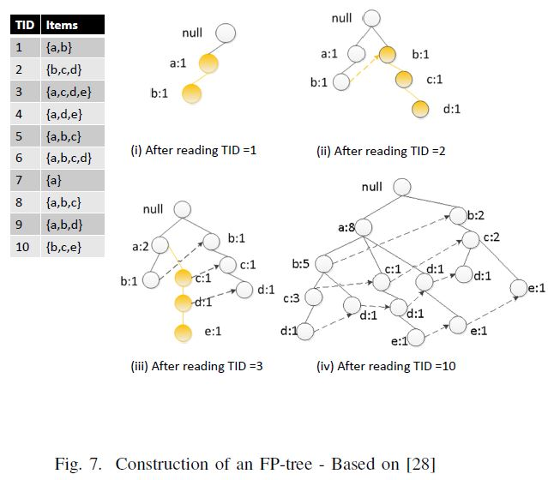
Frequent Pattern Mining (FP Growth Algorithm)
FP builds an “inclusion graph”
reports frequent patterns (itemsets)
works on “categorical” data
data with no meaningful ordering

Slide 42
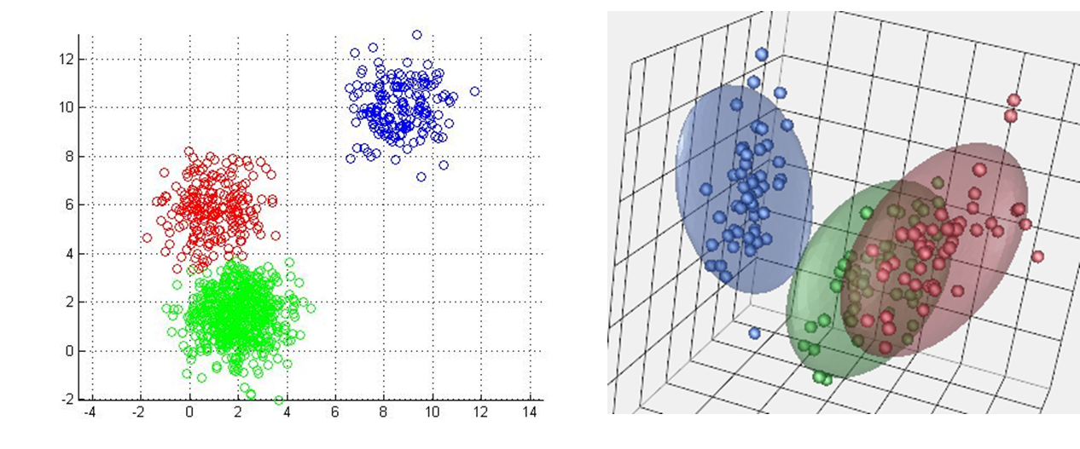
K-Means (K-Means Clustering)
PCA

Slide 43
Putting It All Together
FP Mining finds patterns in categorical data
Returns “itemsets”
Sets of Transaction IDs (TIDs) corresponding to some pattern
[src,dest,srcprt,destprt,oif,appname,…]
K-Means finds clusters in continuous data
A cluster can be things like
The set of TIDs that show congestion, …
Putting these algorithms together allows us to make the following (very) simple inference:
TIDset_{FP} ∧TIDset_{K-Means} → patterns that cluster together
“These application patterns occur with congestion”
TID sets
(clusters)

Slide 44

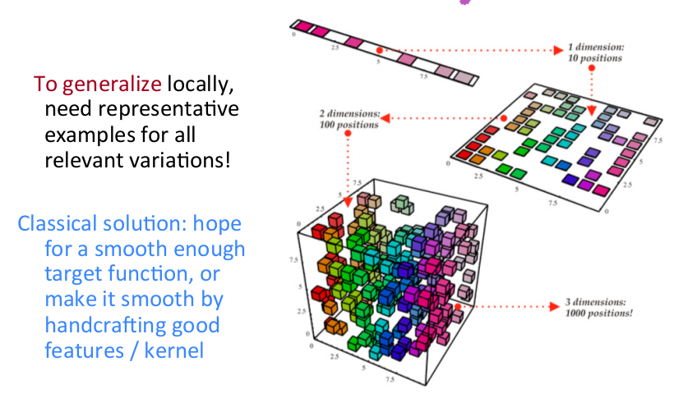
Why not just use an IDS for Anomaly Detection?
IDSes typically use fingerprints, rules and in some cases reputations
All require that you describe the anomaly
This is mathematically equivalent to tiling the input space
For example, suppose you are looking at 100 variables
Then you would have to somehow enumerate 2¹⁰⁰ different classes
Further, suppose you have a billion examples to learn from
Then you miss 2¹⁰⁰ – 10⁹ potential classes, a huge number
Machine learning can in principle generalize to these unseen cases
Whereas an IDS based on fingerprinting or rules can not
But there’s a hitch…
Finally, ML can do sophisticated false positive mitigation

Slide 45
Agenda
Macro Trends Circa 2012: Seeing The Past, Present and Future
What is Machine Learning?
Machine Learning, Anomaly Detection and Cybersecurity
CTO’s Office Machine Learning Initiatives
Industry Cybersecurity Landscape
Summary
Q&A

Slide 46
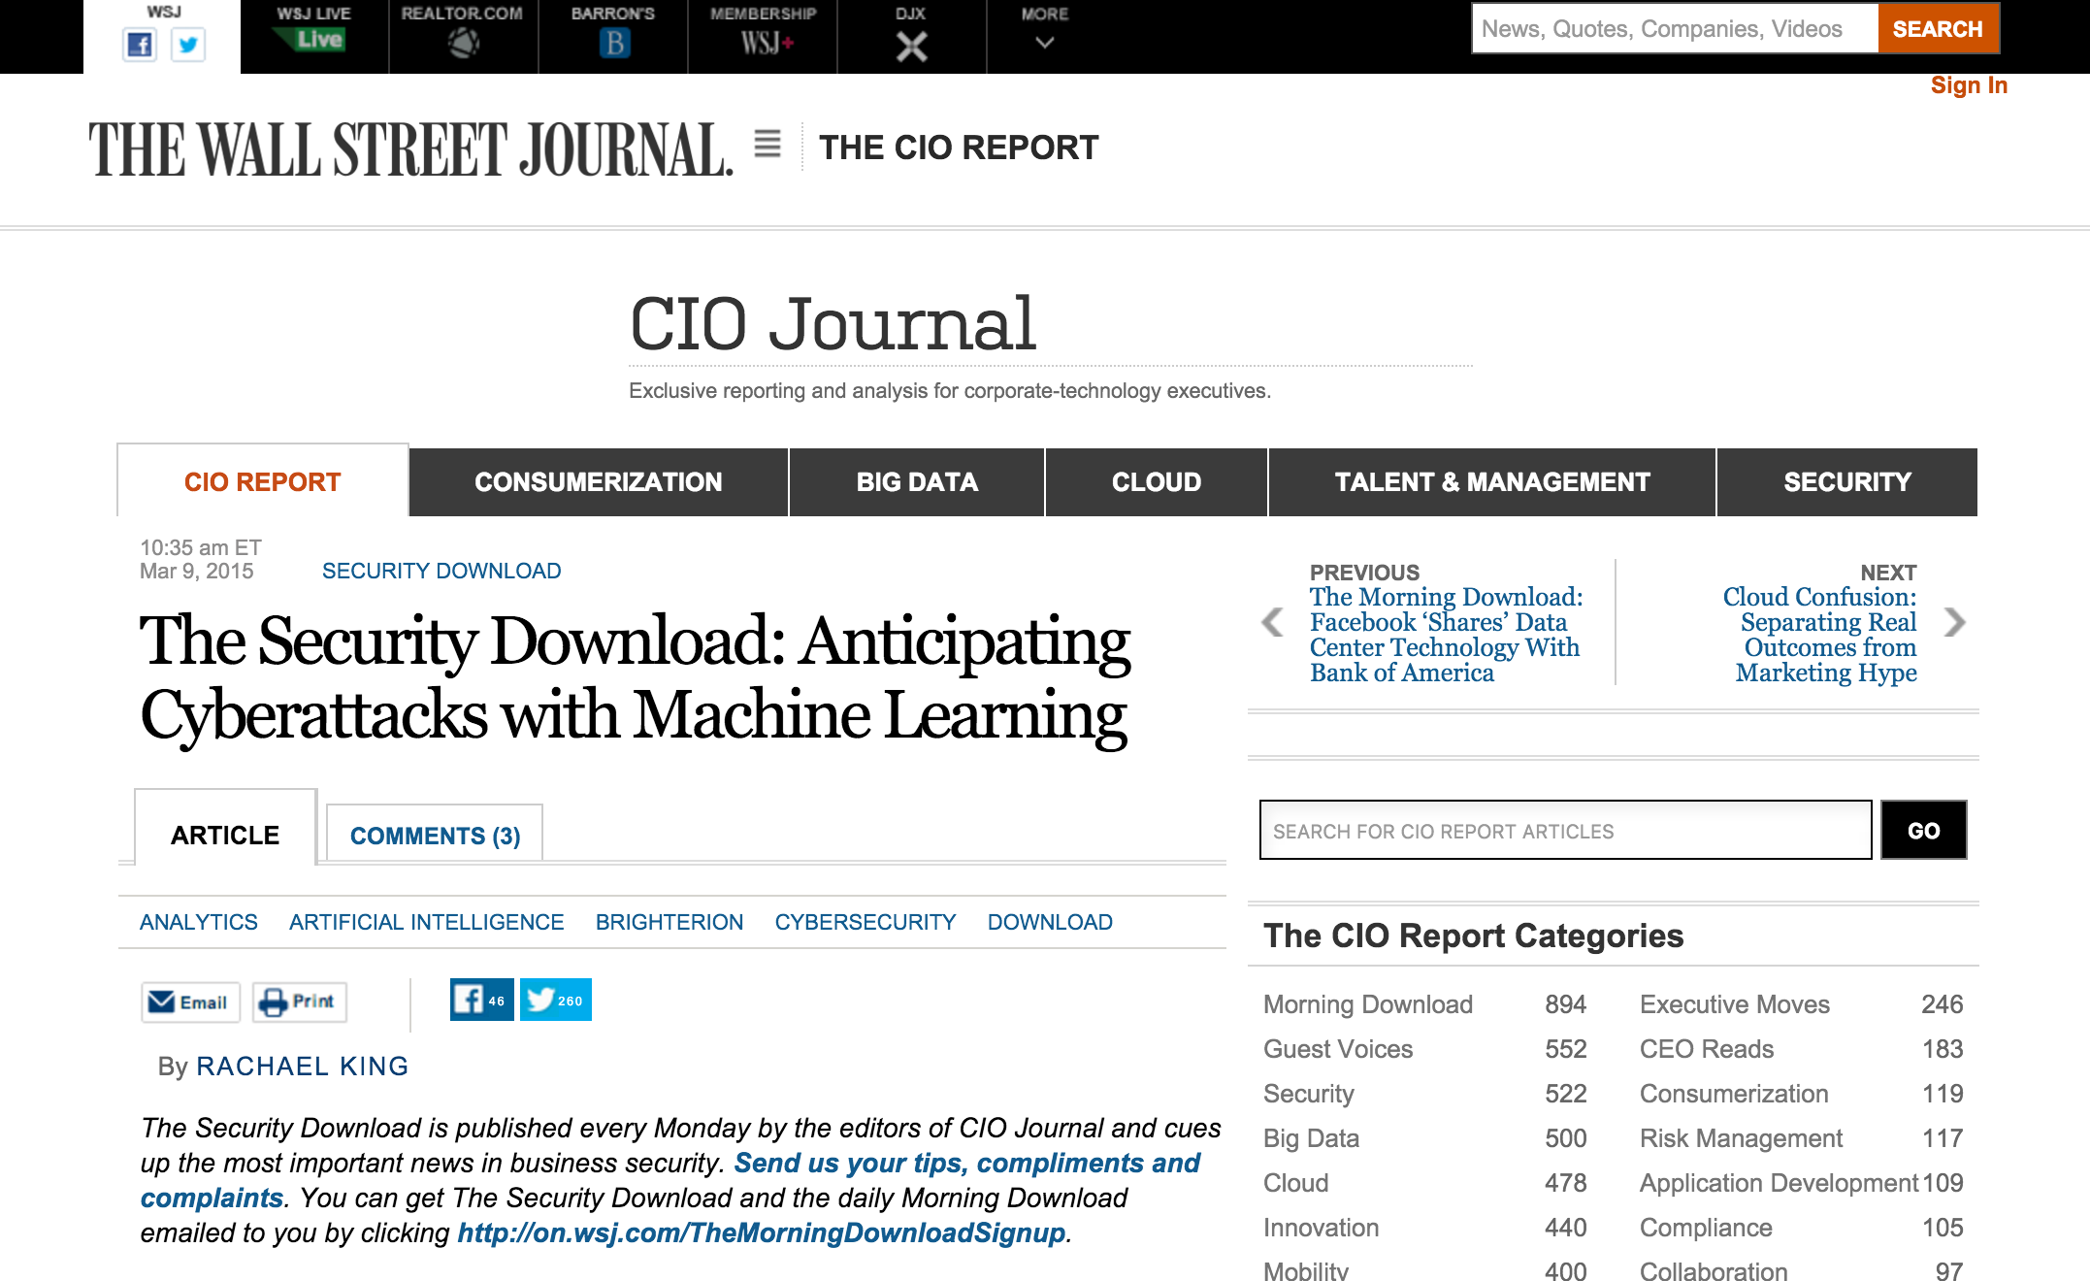

Slide 47
Gartner’s View
According to Gartner, by 2020, 60 percent of digital businesses will fall victim to devastating service failures due to their inability to handle the threats present in new technologies. Digital hazards are so pervasive that Gartner reports that the worldwide security software market grew 4.9 percent and totaled $19.9 billion by the end of 2013.
Market research firm Gartner says global spending on IT security is set to increase 8.2 percent in 2015 to $77 billion, and the world will spend $101 billion on information security in 2018.
The cyber security market is estimated to grow to $170 billion (USD) by 2020, at a Compound Annual Growth Rate (CAGR) of 9.8 percent from 2015 to 2020, according to a report from Markets and Markets. The aerospace, defense, and intelligence vertical continues to be the largest contributor to cybersecurity solutions.

Slide 48
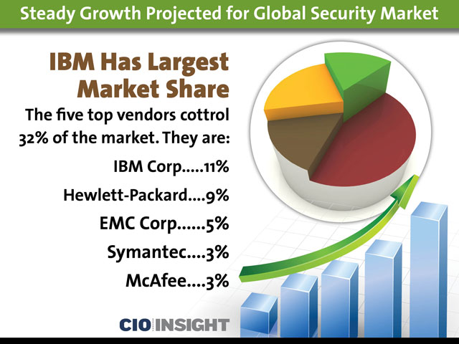
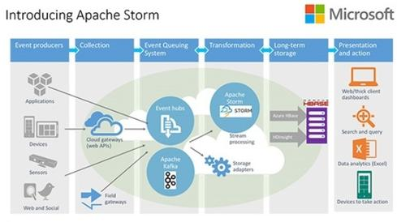


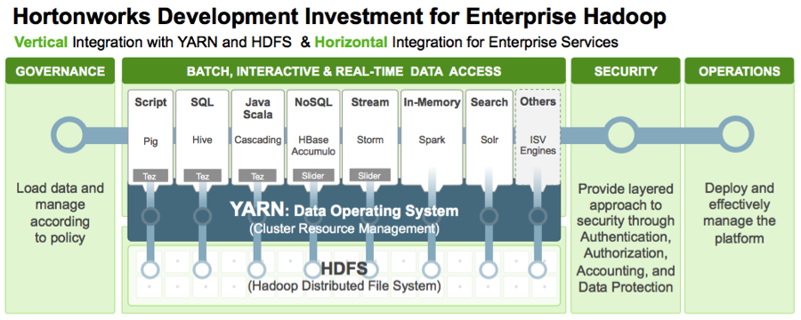
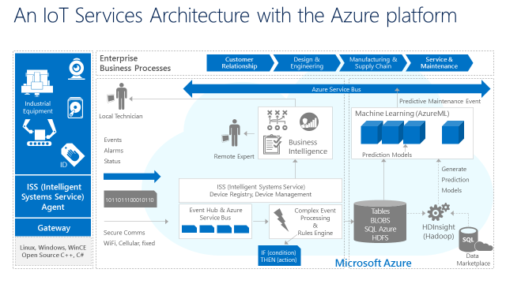
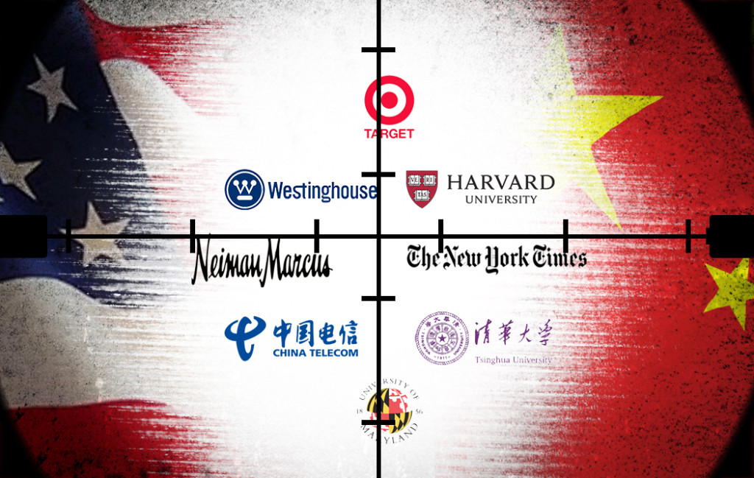
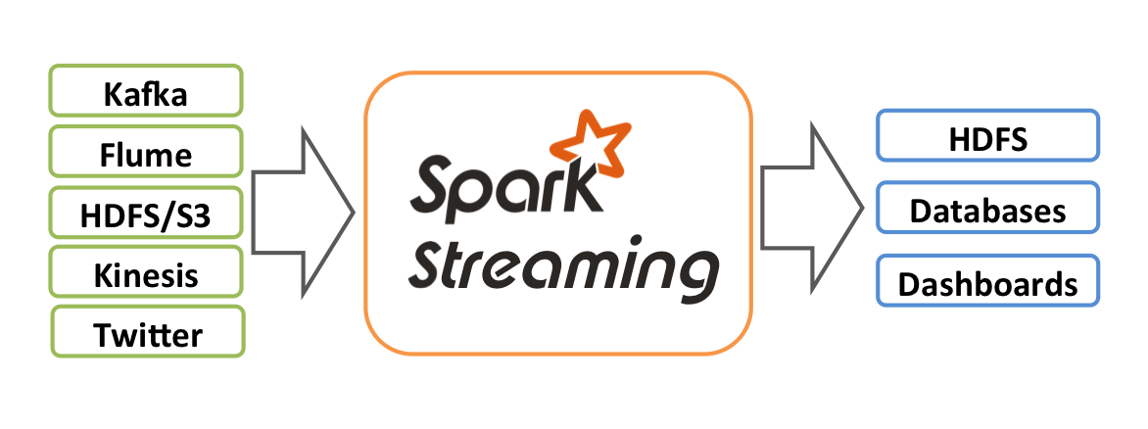


Cybersecurity A Crowded Field

Slide 49
Agenda
Macro Trends Circa 2012: Seeing The Past, Present and Future
What is Machine Learning?
Machine Learning, Anomaly Detection and Cybersecurity
CTO’s Office Machine Learning Initiatives
Industry Cybersecurity Landscape
Summary
Q&A

Slide 50
Summary
Continue developing novel techniques for CSNSE Machine Learning
Continue to position Brocade as the thought leader in this space
Build/Buy/Partner stategy for Cybersecurity
Investigate partnering opportunities (Intel, Splunk, …)
Anomaly Detection
Secure load balancing, Exfiltration, …
CSNSE use cases
Configuration effect prediction, Energy management, …
Outreach to the product groups
vEPC /Path optimization/NFV orchestration
Internal Use Cases
Manufacturing and customer support use cases such as Brocade Service Vision

Slide 51

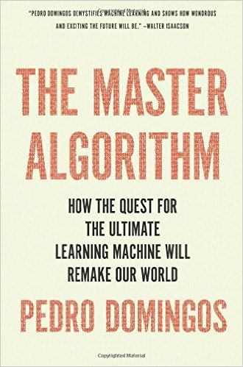
Finally…
Machine learning is a cool new technology, but that’s not why
businesses embrace it. They embrace it because they have no
choice.

Slide 52
Agenda
Macro Trends Circa 2012: Seeing The Past, Present and Future
What is Machine Learning?
Machine Learning, Anomaly Detection and Cybersecurity
CTO’s Office Machine Learning Initiatives
Industry Cybersecurity Landscape
Where We’re Going
Q&A

Slide 53
Q & A
Thanks!

